Slide 1
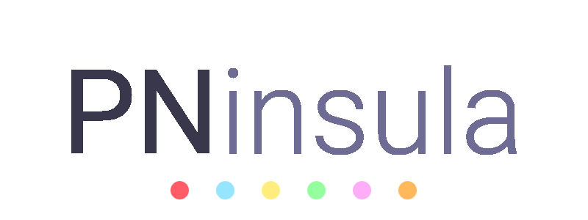
Cross-cultural Pediatric Neuropsychology
Considerations and future directions for an unbiased neuropsychological assessment
Alvaro Lozano-Ruiz
alvlozano@ugr.es

Slide 2
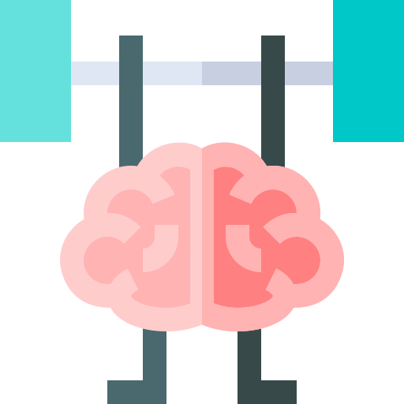
Cross-cultural neuropsychology
“A cross-cultural psychology with a neurological perspective,
or a neuropsychology with a cultural emphasis”
How cultural factors affect neuropsychological performance?
What are the neuropsychological differences across cultures?
Are neuropsychological pathologies affected in the same way across cultures?
PEDIATRIC
Brain maturation & education in progress
Ardila (2020)

Slide 3
Cultural influence on NP assessment from 3 points of view
Examinee
Examiner
Instruments
Culture
Language
Education
Socioeconomic status
Cultural competency
Other practice-related aspects
Construct validity
Equivalence
Norms
Diagnostic validity

Slide 4
Cultural influence: Examinee
Language
Phonology, semantics, vocabulary…
Multilingualism
Laterality & reading system (directionality)
Culture
Education
Cultural traditions, rules and values
Acculturation
Cultural distance
Years of education & illiteracy
Academic achievement & educational style
Test-wiseness & familiarity with school-related aspects
Socioeconomic
Status
Health & nutrition
Home environment
Level of education & job of both parents
Olson & Jacobson (2015)

Slide 5
Cultural influence: Examinee > Culture > Acculturation
“The process by which a human being acquires the culture of a particular society”
Cultures have an internal “normal distribution”
No individual or subgroup represents all of a culture’s value
Bidimensional approach:
adoption + maintenance
affect NP performance
Tan et al. (2020); Valle (2002)

Slide 6
Cultural influence: Examinee > Language
Children may be multilingual, but their proficiency may be different
Code-switching may influence the validity of the assessment
A simple translation of a test is not enough (some words in one language may no exist in another one, or have a different meaning)
Robust back-translation procedures are needed (International Test Commission guidelines)
Echemendia et al. (1997); Hambleton (2005)

Slide 7
Cultural influence: Examinee > Language > Directionality
Reading direction | ← | →
Time orientation | FUTURE ← PRESENT ← PAST | PAST → PRESENT → FUTURE
Aesthetic preferences
De Agostini & Chokron (2000, 2002); Ouellet et al. (2010)

Slide 8
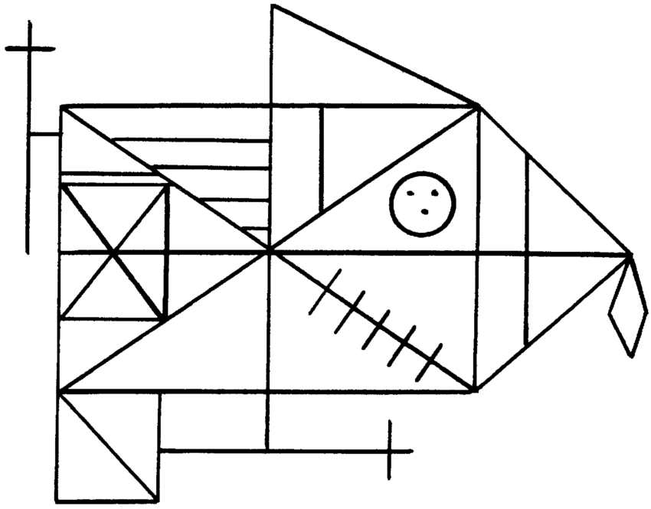
Cultural influence: Examinee > Language > Directionality
The greater the directionality, the better the execution when the figure points to the side on which the subject reads and writes
Portex et al. (2017)

Slide 9
Cultural influence: Examinee > Education
Years of education (quantitative) ≠ quality of education (qualitative) (e.g. some cultures use rote-learning while others teach under role playing)
Most neuropsychological instruments assess cognitive abilities through procedures and materials also used in schools → the more higher education, the better performance
Familiarity with tests (test-wiseness), with technology, or with geometry, arithmetic, or the use of a pencil can qualitatively affect the assessment
Puente & Ardila (2000); Olson & Jacobson (2015)

Slide 10
Cultural influence: Examiner
Interpreters
Language proficiency
Caregivers
Cultural competency
Family roles
Olson & Jacobson (2015)

Slide 11
Cultural influence: Instruments
Construct validity
Equivalence
Norms
Diagnostic validity
Tests must tap into the same cognitive ability across different cultures
Tests must have the same meaning and interpretation across different cultures
Normative data in specific populations is scarce (e.g. Arab World) or non- representative
Test must differentiate a child with a disorder from a healthy one
Fasfous et al. (2017); Pedraza & Mungas (2008); Olson & Jacobson (2015)

Slide 12
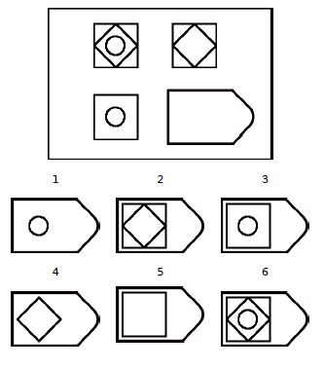
Cultural influence: Instruments > Raven’s Progressive Matrices
Raven's Progressive Matrices
Non-verbal test, supposedly “culture-free”, used to study intelligence
Normative data collected in the UK in 1982 (5 to 11 years old for the Coloured version)
As of today
Application of UK norms in other countries indistinctly (clinic and research)
Publications with wrong IQ transformations
Despite the fact that...
Western tests are not applicable to other cultures (Greenfield, 1997)
Intelligence tests do not always measure intelligence (Fasfous et al., 2013)

Slide 13
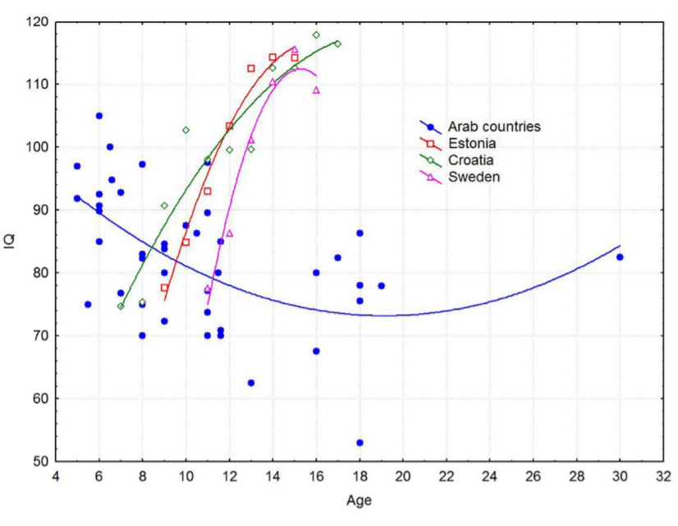
Cultural influence: Instruments > Raven’s Progressive Matrices
“Arab children exhibit an age-dependent IQ decline relative to Caucasian children”
Bakhiet et al. (2018)

Slide 14
Cultural influence: Instruments > Raven’s Progressive Matrices
Construct validity
Equivalence
Norms
Diagnostic validity
Tests must tap into the same cognitive ability across different cultures
Tests must have the same meaning and interpretation across different cultures
Normative data in specific populations is scarce (e.g. Arab World) or non- representative
Test must differentiate a child with a disorder from a healthy one
No evidence that they are measuring intelligence
No evidence of equivalence (always same version)
Transformed raw scores into IQ using 1982 UK norms

Slide 15
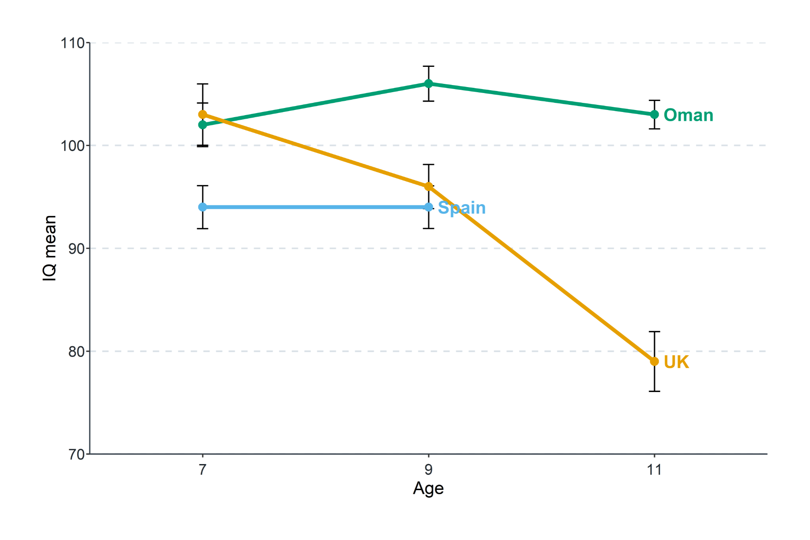
Cultural influence: Instruments > Raven’s Progressive Matrices
Participants
147 healthy Moroccan children 7, 9 and 11 years old
Transformation of their raw scores to IQ on purpose using Spanish, Omani and British norms
Results
Up to 15% of children with supposedly 'intellectual impairment', and up to 62.50% with "below average" IQ using UK norms
< 80 IQ at 11 y.o. when using UK norms
Misdiagnosis together with the DSM-5 (not a culture-free test)
Lozano-Ruiz et al. (2021)

Slide 16
Future directions
Comprehensive neuropsychological assessment in combination with other questionnaires assessing cultural factors (e.g. SES and acculturation)
Developing new norms and instruments for specific populations
Professional practice training in neuropsychological assessment and cultural competences
Inclusion of interpreters in the neuropsychological assessment when needed
Fight against racial, social & political injustices

Slide 17
References
Ardila, A. (2020). Cross-cultural neuropsychology: History and prospects. RUDN Journal of Psychology and Pedagogics, 17(1), 64-78.
Bakhiet, S. F. A., Dutton, E., Ashaer, K. Y. A., Essa, Y. A. S., Blahmar, T. A. M., Hakami, S. M., & Madison, G. (2018). Understanding the Simber Effect: Why is the age-dependent increase in children's cognitive ability smaller in Arab countries than in Britain?. Personality and Individual Differences, 122, 38-42.
Chokron, S., & De Agostini, M. (2000). Reading habits influence aesthetic preference. Cognitive Brain Research, 10(1-2), 45-49.
De Agostini, M., & Chokron, S. (2002). The influence of handedness on profile and line drawing directionality in children, young, and older normal adults. Brain and Cognition.
Echemendia, R. J., Harris, J. G., Congett, S. M., Diaz, M. L., & Puente, A. E. (1997). Neuropsychological training and practices with Hispanics: A national survey. The Clinical Neuropsychologist, 11(3), 229-243.
Fasfous, A. F., Hidalgo-Ruzzante, N., Vilar-López, R., Catena-Martínez, A., & Pérez-García, M. (2013). Cultural differences in neuropsychological abilities required to perform intelligence tasks. Archives of clinical neuropsychology, 28(8), 784-790.
Fasfous, A. F., Al-Joudi, H. F., Puente, A. E., & Pérez-García, M. (2017). Neuropsychological measures in the Arab world: A systematic review. Neuropsychology review, 27(2), 158-173.
Greenfield, P. M. (1997). You can't take it with you: Why ability assessments don't cross cultures. American psychologist, 52(10), 1115.
Hambleton, R. K. (2005). Issues, designs and technical guidelines for adapting tests into multiple languages and cultures. In R. K. Hambleton, P. F. Merenda, & C. D. Spielberger (Eds.), Adapting psychological and educational tests for cross-cultural assessment (pp. 3–38). Mahwah, NJ: Lawrence Erlbaum.

Slide 18
References
Lozano-Ruiz, A., Fasfous, A. F., Ibanez-Casas, I., Cruz-Quintana, F., Perez-Garcia, M., & Pérez-Marfil, M. N. (2021). Cultural Bias in Intelligence Assessment Using a Culture-Free Test in Moroccan Children. Archives of Clinical Neuropsychology.
Olson, K., & Jacobson, K. (2015). Cross-cultural considerations in pediatric neuropsychology: A review and call to attention. Applied Neuropsychology: Child, 4(3), 166-177.
Ouellet, M., Santiago, J., Israeli, Z., & Gabay, S. (2010). Is the future the right time?. Experimental psychology.
Pedraza, O., & Mungas, D. (2008). Measurement in cross-cultural neuropsychology. Neuropsychology review, 18(3), 184-193.
Portex, M., Foulin, J. N., & Troadec, B. (2017). Cultural influence on directional tendencies in children’s drawing. Laterality: Asymmetries of Body, Brain and Cognition, 22(5), 621-640.
Puente, A. E., & Ardila, A. (2000). Neuropsychological assessment of Hispanics. In E. Fletcher-Janzen, T. Strickland, & C. R. Reynolds (Eds.), Handbook of cross-cultural neuropsychology (pp. 87–104). New York, NY: Kluwer Academic=Plenum
Tan, Y. W., Burgess, G. H., & Green, R. J. (2021). The effects of acculturation on neuropsychological test performance: A systematic literature review. The Clinical Neuropsychologist, 35(3), 541-571.
Valle, D. S. (2002). The role of acculturation in leader-member exchange.

Slide 19
Additional recommended bibliography
Ardila, A. (1995). Directions of research in cross-cultural neuropsychology. Journal of clinical and experimental neuropsychology, 17(1), 143-150.
Brickman, A. M., Cabo, R., & Manly, J. J. (2006). Ethical issues in cross-cultural neuropsychology. Applied Neuropsychology, 13(2), 91-100.
Fernández, A. L., & Abe, J. (2018). Bias in cross-cultural neuropsychological testing: problems and possible solutions. Culture and Brain, 6(1), 1-35.
Fernandez, A. L. (2019). Modern neuropsychological tests for a diversity of cultural contexts. The Clinical Neuropsychologist, 33(2), 438-445.
Franzen, S., Bekkhus-Wetterberg, P., van den Berg, E., Calia, C., Canevelli, M., Daugherty, J. C., Fasfous, A. F., Goudsmit, M., Ibanez-Casas, I., Lozano-Ruiz, A., Mukadam, N., Narme, P., Nielsen, T. R., Papma, J. M., Pomati, S., & Watermeyer, T. J. (2021). Cross-cultural neuropsychological assessment in Europe: position statement of the European Consortium on Cross-Cultural Neuropsychology (ECCroN). The Clinical Neuropsychologist.
Fujii, D. E. (2018). Developing a cultural context for conducting a neuropsychological evaluation with a culturally diverse client: The ECLECTIC framework. The Clinical Neuropsychologist, 32(8), 1356-1392.
Thalmayer, A. G., Toscanelli, C., & Arnett, J. J. (2021). The neglected 95% revisited: Is American psychology becoming less American?. American Psychologist, 76(1), 116.

Slide 20
Cross-cultural Pediatric Neuropsychology
Considerations and future directions for an unbiased neuropsychological assessment
Alvaro Lozano-Ruiz
alvlozano@ugr.es
Thank you!

